Slide 1
Regularization

Slide 2
Regularization
L1-norm:
LASSO model：Tibshirani,1996
L2-norm:
Ridge model：Hoerl, Kennard,1970
Elastic Net: (L1 + L2)

Slide 3
Regularization
New loss function to be minimized
Find a set of weight not only minimizing original cost but also close to zero
Regularization term
Original loss
(e.g. minimize square error, cross entropy …)
L2 regularization:
(usually not consider biases)
Notes:
L1 is also good, subtle difference

Slide 4
Regularization
L2 regularization:
New loss function to be minimized
Gradient:
Update:
Weight Decay
Closer to 1
Notes:
If p=2, then the regularizer is also called “weight decay”.

Slide 5
Regularization
L1 regularization:
New loss function to be minimized
Update:
Always delete
…… L2
Notes:
If p=2, then the regularizer is also called “weight decay”.

Slide 6
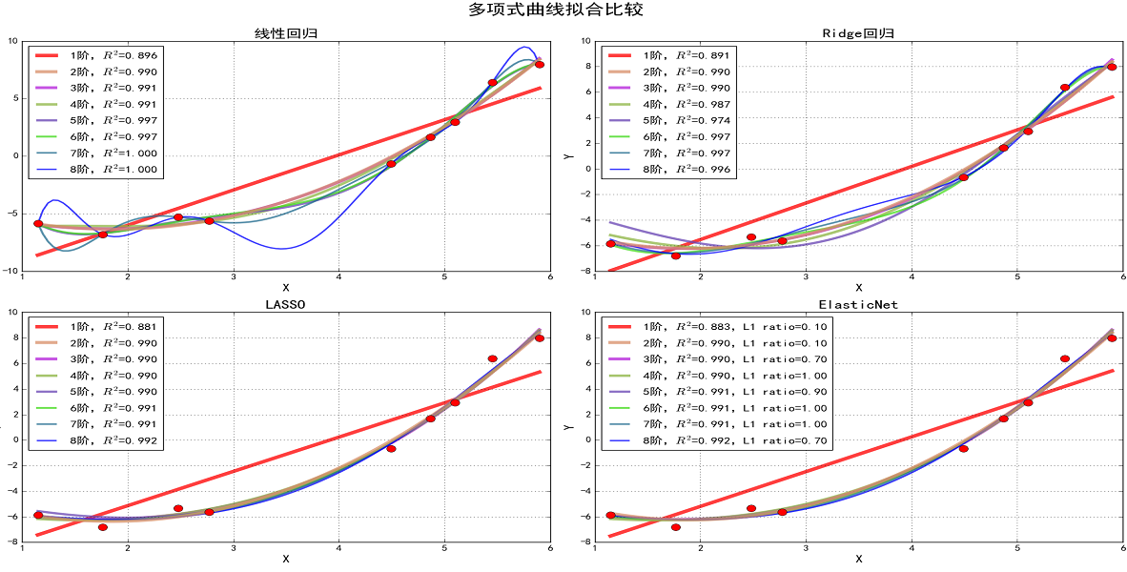
y = x**2 - 4*x - 3 + np.random.randn(9)
https://blog.csdn.net/zql898626913/article/details/80958206

Slide 7
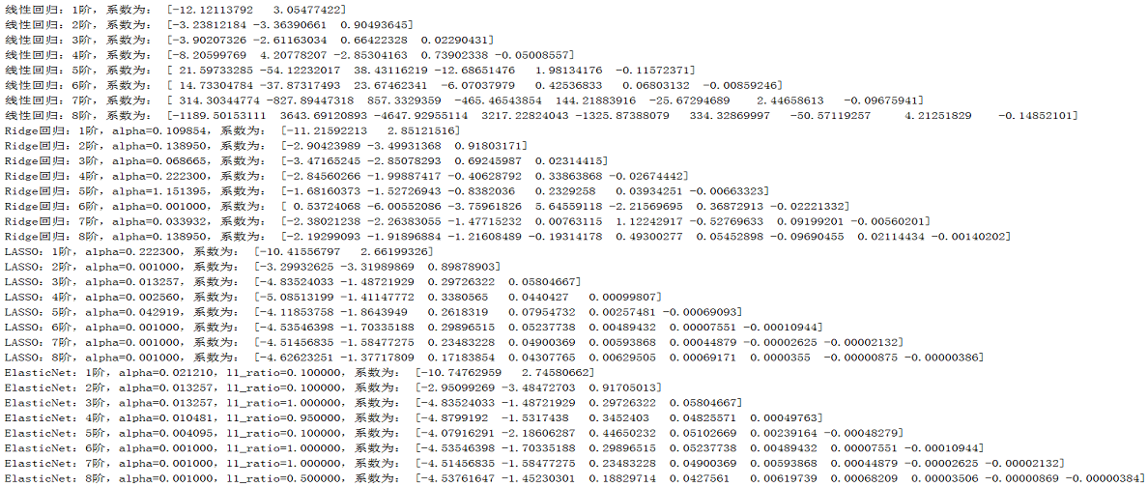

Slide 8
regularization in SKLearn
Advertising.py
ElasticNet.py
LinearRegression_CV.py

Slide 9
Gradient Descent
Notes:
Stochastic
Data normalization
Mine ,,,,,,

Slide 10
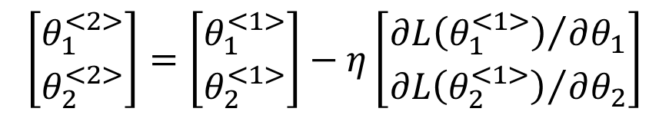
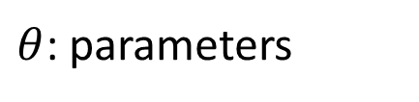
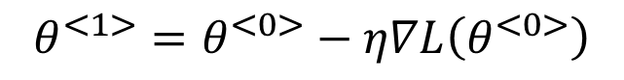
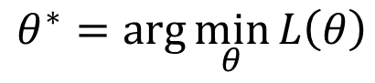
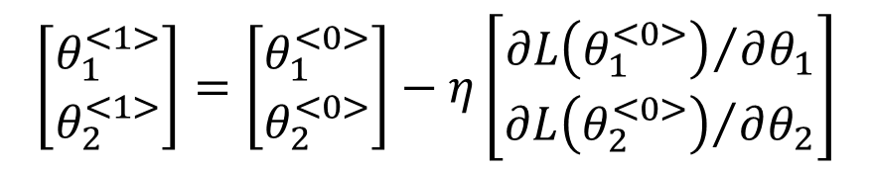
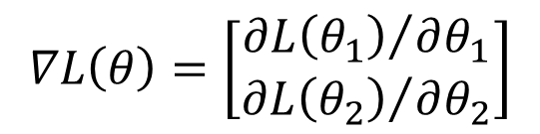
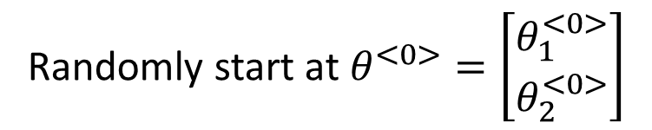
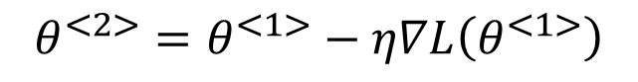
Review: Gradient Descent
In step 3, we have to solve the following optimization problem:
$$θ^{∗}=arg\min_{θ}{L\left(θ\right)}$$
L: loss function
$θ$: parameters
Suppose that θ has two variables {θ₁, θ₂}
Randomly start at $θ^{<0>}=\left[\begin{matrix}θ_{1}^{<0>} \\ θ_{2}^{<0>}\end{matrix}\right]$
$$∇L\left(θ\right)=\left[\begin{matrix}{∂L\left(θ_{1}\right)}/{∂θ_{1}} \\ {∂L\left(θ_{2}\right)}/{∂θ_{2}}\end{matrix}\right]$$
$$\left[\begin{matrix}θ_{1}^{<1>} \\ θ_{2}^{<1>}\end{matrix}\right]=\left[\begin{matrix}θ_{1}^{<0>} \\ θ_{2}^{<0>}\end{matrix}\right]−η\left[\begin{matrix}{∂L\left(θ_{1}^{<0>}\right)}/{∂θ_{1}} \\ {∂L\left(θ_{2}^{<0>}\right)}/{∂θ_{2}}\end{matrix}\right]$$
$$θ^{<1>}=θ^{<0>}−η∇L\left(θ^{<0>}\right)$$
$$\left[\begin{matrix}θ_{1}^{<2>} \\ θ_{2}^{<2>}\end{matrix}\right]=\left[\begin{matrix}θ_{1}^{<1>} \\ θ_{2}^{<1>}\end{matrix}\right]−η\left[\begin{matrix}{∂L\left(θ_{1}^{<1>}\right)}/{∂θ_{1}} \\ {∂L\left(θ_{2}^{<1>}\right)}/{∂θ_{2}}\end{matrix}\right]$$
$$θ^{<2>}=θ^{<1>}−η∇L\left(θ^{<1>}\right)$$

Slide 11
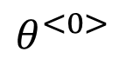
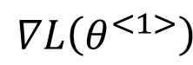
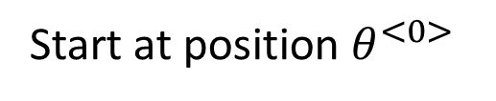
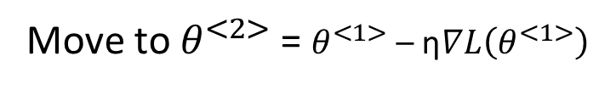
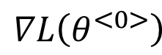
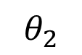
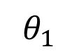
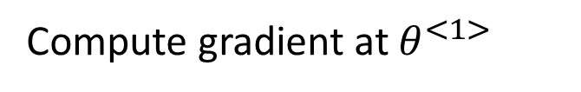
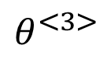
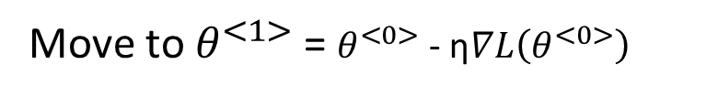
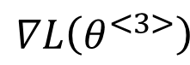
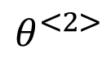
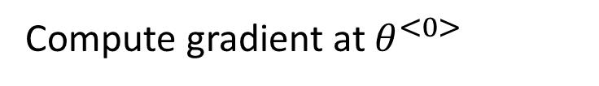
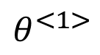
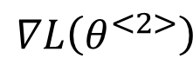
Review: Gradient Descent
$$θ_{2}$$
Gradient: Loss 的等高线的法线方向
$$∇L\left(θ^{<0>}\right)$$
Start at position $θ^{<0>}$
$$θ^{<0>}$$
$$∇L\left(θ^{<1>}\right)$$
Compute gradient at $θ^{<0>}$
$$θ^{<1>}$$
$$∇L\left(θ^{<2>}\right)$$
Move to $θ^{<1>}$ = $θ^{<0>}$ - η$∇L\left(θ^{<0>}\right)$
$$θ^{<2>}$$
Gradient
Compute gradient at $θ^{<1>}$
Movement
$$∇L\left(θ^{<3>}\right)$$
$$θ^{<3>}$$
Move to $θ^{<2>}$ = $θ^{<1>}$ – η$∇L\left(θ^{<1>}\right)$
……
$$θ_{1}$$
Notes:
Draw is so comply use minecraft
Easy for more than two variables

Slide 12
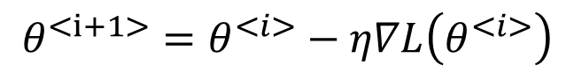
Gradient Descent in Tensorflow
$$θ^{<i+1>}=θ^{<i>}−η∇L\left(θ^{<i>}\right)$$
#minimize
train = tf.train.GradientDescentOptimizer(learning_rate=0.1).minimize(cost)
# Launch the graph in a session.
sess = tf.Session()
# Initializes global variables in the graph.
sess.run(tf.global_variables_initializer())
# Fit the line
for step in range(2001):
sess.run(train)
2001 iterations

Slide 13
Gradient Descent Tips
Make the training faster
Tip 1: Feature Scaling/Normalization
Tip 2: Variants of Gradient Descent
Stochastic Gradient Descent, Mini-batch Gradient Descent
Tip 3: Tuning your learning rates
Others: Vanishing/exploding gradients (later in DNN)

Slide 14
Gradient Descent
Tip 1: Feature Scaling

Slide 15
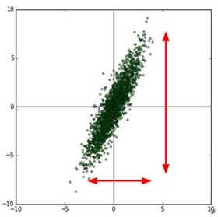
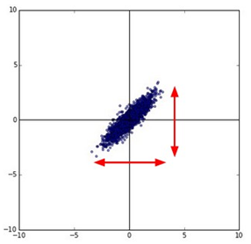
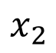
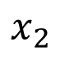
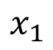
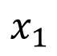
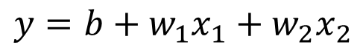
Feature Scaling
Source of figure: http://cs231n.github.io/neural-networks-2/
$$y=b+w_{1}x_{1}+w_{2}x_{2}$$
$$x_{2}$$
$$x_{2}$$
$$x_{1}$$
$$x_{1}$$
Make different features have the same scaling

Slide 16
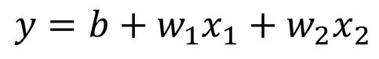
Feature Scaling
$$y=b+w_{1}x_{1}+w_{2}x_{2}$$
1, 2 ……
1, 2 ……
100, 200 ……
1, 2 ……
Loss L
Loss L

Slide 17
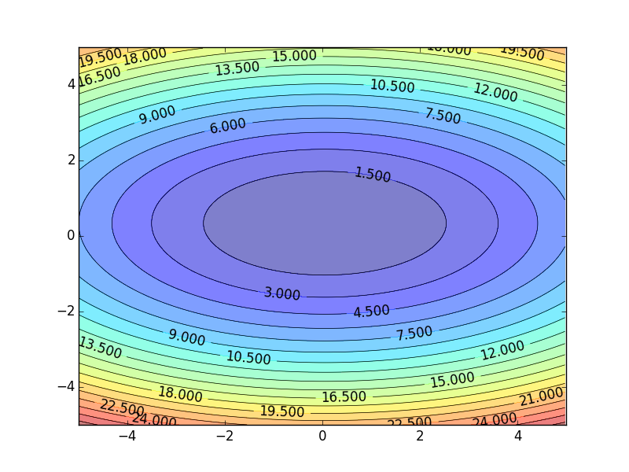
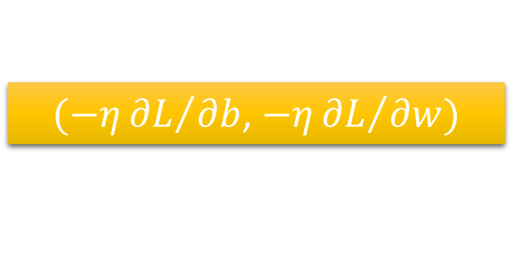
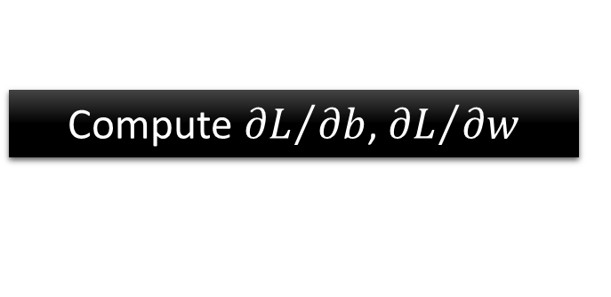

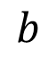
Color: Value of Loss L(w,b)
$$w$$
$(−η{∂L}/{∂b}$, $−η{∂L}/{∂w})$
Compute ${∂L}/{∂b}$, ${∂L}/{∂w}$
$$b$$

Slide 18
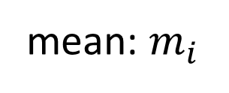
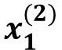
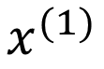
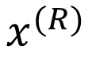
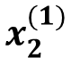
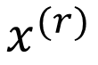
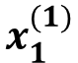
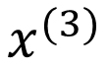
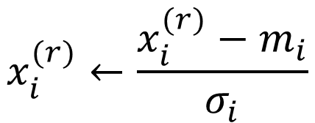
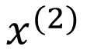
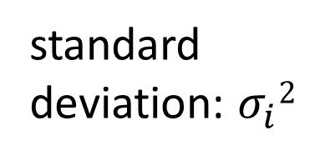
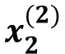
Feature Scaling on all data sets
$$x^{(1)}$$
$$x^{(2)}$$
$$x^{(3)}$$
$$x^{(r)}$$
$$x^{(R)}$$
For each dimension i:
$$x_{1}^{(1)}$$
$$x_{1}^{(2)}$$
$$x_{2}^{(1)}$$
$$x_{2}^{(2)}$$
……
……
mean: $m_{i}$
……
……
……
……
……
standard deviation: $σ_{i}2$
$$x_{i}^{(r)}←\frac{x_{i}^{(r)}−m_{i}}{σ_{i}}$$
The means of all dimensions are 0, and the variances are all 1

Slide 19



m_{i}, $σ_{i}2$ are computed based on the entire training data
Assume f(x₁,x₂)=w₁*x₁+w₂*x₂+b
f’(x₁’,x₂’)=w₁’*x’₁+w₂’*x’₂+b’
w₁=$\frac{\text{w}\text{1}\text{’} }{σ_{1}}$ , w₂=$\frac{\text{w}\text{2}\text{’} }{σ_{2}}$ , b=b’- $\frac{\text{w}\text{1}\text{’}\text{∗}\text{mi} }{σ_{1}}$ - $\frac{\text{w}\text{2}\text{’∗}\text{m}\text{2} }{σ_{2}}$
$${x′}_{i}^{(r)}←\frac{x_{i}^{(r)}−m_{i}}{σ_{i}}$$
Input feature-scaled training data to BGD to find the optimized ’(w₁’,w₂’,b’)
Do the same feature scaling for Dev/Val dataset, then compute the fitting error.

Slide 20
Gradient Descent
Tip 2: Variants of Gradient Descent

Slide 21


Stochastic Gradient Descent
$$L=\sum_{j}{{\left({\hat{y}}^{(j)}−\left(b+ \sum{w_{i}x_{i}^{(j)}}\right)\right)}^{2}}$$
BGD: Loss is the summation over all training examples
Batch Gradient Descent (BGD)
Vanilla gradient descent
Gradient Descent
Stochastic Gradient Descent
Faster!
Pick an example x^{(j)}
$$L^{(j)}={\left({\hat{y}}^{(j)}−\left(b+ \sum{w_{i}x_{i}^{(j)}}\right)\right)}^{2}$$
Loss for only one example
Notes:
See all the examples once = 1 epoch
Two approaches update the parameters towards the same direction, but stochastic is faster!

Slide 22


Batch Gradient Descent (BGD)

Slide 23


Stochastic Gradient Descent (SGD)

Slide 24


Stochastic Gradient Descent (SGD)
Stochastic Gradient Descent
Gradient Descent
Update for each example
Update after seeing all examples
If there are 20 examples,
20 times faster.
See all examples
See only one example
See all examples
Notes:
Full?

Slide 25


Slide 26

Mini-batch Gradient Descent (MBGD)
Mini-batch GD(MBGD)
tradeoff between SGD and GD
BatchSize: 1 ~ #(training data)
Update the parameters once using BatchSize samples
Notes:
batch gradient descent

Slide 27
Review: BGD, MBGD, SGD
SGD
Update the parameters once using one sample
BGD
Update the parameters once using all the training samples
Mini-batch GD(MBGD)
tradeoff between SGD and GD
BatchSize: 1 ~ number of training data
Update the parameters once using a part of the training samples dependent to BatchSize
Note: Training Error are computed on the entire training data to plot the loss curve.

Slide 28
Epoch:
1 epoch means that all the samples in the set are used once.
Iteration:
#(Batch)
Batch-size:
The number of data in one iteration
Notes:
训练集有1000个样本，batchsize=10，那么： 训练完整一个样本集需要： 100次iteration，1次epoch。

Slide 29


Gradient Descent
$$∇L\left(θ\right)=\left[\begin{matrix}{∂L\left(θ_{1}\right)}/{∂θ_{1}} \\ {∂L\left(θ_{2}\right)}/{∂θ_{2}}\end{matrix}\right]$$
$$θ^{<i+1>}=θ^{<i>}−η∇L\left(θ^{<i>}\right)$$
Tip 3: Tuning your
learning rates

Slide 30
Gradient Descent Optimizers in Tensorflow
BGD, SGD, MBGD
# Minimize
optimizer = tf.train.GradientDescentOptimizer(learning_rate=0.01)
train = optimizer.minimize(cost)
tf.train.AdadeltaOptimizer
tf.train.AdagradOptimizer
tf.train.AdagradDAOptimizer
tf.train.MomentumOptimizer
tf.train.AdamOptimizer
tf.train.FtrlOptimizer
tf.train.ProximalGradientDescentOptimizer
tf.train.ProximalAdagradOptimizer
tf.train.RMSPropOptimizer
tf.train.ProximalAdagradOptimizer0
Adagrad
Momentum
Adam:RMSProp +Momentum
RMSProp
https://www.tensorflow.org/api_guides/python/train
Notes:
SGD, RMSprop, Adagrad, Adadelta, Adam, Adamax, Nadam

Slide 31

ADAM: a method for stochastic optimization
[Kingma et al. 2015]

Slide 32
Use Adam Optimizer
# define cost/loss & optimizer
cost = tf.reduce_mean(tf.nn.softmax_cross_entropy_with_logits(
logits=hypothesis, labels=Y))
optimizer = tf.train.AdamOptimizer(learning_rate=learning_rate).minimize(cost)

Slide 33
Learning Rate
Set the learning rate η carefully
If there are more than three parameters, you cannot visualize this.
Loss
Learning Curve
Very Large
small
Large
Loss
Just make
No. of parameters updates
But you can always visualize this.
Loss Surface

Slide 34

Adaptive Learning Rates
Popular & Simple Idea: Reduce the learning rate by some factor every few epochs.
At the beginning, we are far from the destination, so we use larger learning rate
After several epochs, we are close to the destination, so we reduce the learning rate
E.g. 1/t decay: $η^{<t>}=η/{\sqrt{t+1}}$
Learning rate cannot be one-size-fits-all
Giving different parameters different learning rates

Slide 35




Adagrad
$$η^{<t>}=\frac{η}{\sqrt{t+1}}$$
$$g^{<t>}=\frac{∂L\left(θ^{<t>}\right)}{∂w}$$
Divide the learning rate of each parameter by the root mean square of its previous derivatives
Vanilla Gradient descent
w is one parameters
$$w^{<t+1>}←w^{<t>}−{\text{η}}^{<t>}g^{<t>}$$
Adagrad
$σ^{t}$: root mean square of the previous derivatives of parameter w
$$w^{<t+1>}←w^{<t>}−\frac{{\text{η}}^{<t>}}{σ^{<t>}}g^{<t>}$$
Parameter dependent

Slide 36










Adagrad
$σ^{<t>}$: root mean square of the previous derivatives of parameter w
$$w^{<1>}←w^{<0>}−\frac{{\text{η}}^{<0>}}{σ^{<0>}}g^{<0>}$$
$$σ^{<0>}=\sqrt{{\left(g^{<0>}\right)}^{2}}$$
$$σ^{<1>}=\sqrt{\frac{1}{2}\left[{\left(g^{<0>}\right)}^{2}+{\left(g^{<1>}\right)}^{2}\right]}$$
$$w^{<2>}←w^{<1>}−\frac{{\text{η}}^{<1>}}{σ^{<1>}}g^{<1>}$$
$$σ^{<2>}=\sqrt{\frac{1}{3}\left[{\left(g^{<0>}\right)}^{2}+{\left(g^{<1>}\right)}^{2}+{\left(g^{<2>}\right)}^{2}\right]}$$
$$w^{<3>}←w^{<2>}−\frac{{\text{η}}^{<2>}}{σ^{<2>}}g^{<2>}$$
$$σ^{<t>}=\sqrt{\frac{1}{t+1}\sum_{i=0}^{t}{{\left(g^{<i>}\right)}^{2}}}$$
$$……$$
$$w^{<t+1>}←w^{<t>}−\frac{{\text{η}}^{<t>}}{σ^{<t>}}g^{<t>}$$

Slide 37






Adagrad
Divide the learning rate of each parameter by the root mean square of its previous derivatives
$$η^{<t>}=\frac{η}{\sqrt{t+1}}$$
1/t decay
$${\text{η}}^{<t>}$$
$$w^{<t+1>}←w^{<t>}−\frac{η}{σ^{<t>}}g^{<t>}$$
$$σ^{<t>}=\sqrt{\frac{1}{t+1}\sum_{i=0}^{t}{{\left(g^{<i>}\right)}^{2}}}$$
$$σ^{<t>}$$
$$w^{<t+1>}←w^{<t>}−\frac{η}{\sqrt{\sum_{i=0}^{t}{{\left(g^{<i>}\right)}^{2}}}}g^{<t>}$$

Slide 38



Contradiction?
$$η^{<t>}=\frac{η}{\sqrt{t+1}}$$
$$g^{<t>}=\frac{∂L\left(θ^{<t>}\right)}{∂w}$$
Vanilla Gradient descent
Larger gradient,
larger step
$$w^{<t+1>}←w^{<t>}−{\text{η}}^{<t>}g^{<t>}$$
Adagrad
Larger gradient,
larger step
$$w^{<t+1>}←w^{<t>}−\frac{η}{\sqrt{\sum_{i=0}^{t}{{\left(g^{<i>}\right)}^{2}}}}g^{<t>}$$
Larger gradient, smaller step
Notes:
Contradiction??????

Slide 39



Intuitive Reason
$$η^{<t>}=\frac{η}{\sqrt{t+1}}$$
$$g^{<t>}=\frac{∂L\left(θ^{<t>}\right)}{∂w}$$
How surprise it is
反差
特別大
g^{<0>} | g^{<1>} | g^{<2>} | g^{<3>} | g^{<4>} | ……
0.001 | 0.001 | 0.003 | 0.002 | 0.1 | ……
g^{<0>} | g^{<1>} | g^{<2>} | g^{<3>} | g^{<4>} | ……
10.8 | 20.9 | 31.7 | 12.1 | 0.1 | ……
特別小
$$w^{<t+1>}←w^{<t>}−\frac{η}{\sqrt{\sum_{i=0}^{t}{{\left(g^{<i>}\right)}^{2}}}}g^{<t>}$$
造成反差的效果

Slide 40










Larger gradient, larger steps?
Best step:
$$|x_{0}+\frac{b}{2a}|$$
$$\frac{|2ax_{0}+b| }{2a}$$
Larger 1st order derivative means how far from the minima
$$x_{0}$$
$$−\frac{b}{2a}$$
$$y=ax^{2}+bx+c$$
$$|2ax_{0}+b|$$
$$\left|\frac{∂y}{∂x}\right|=|2ax+b|$$
$$x_{0}$$

Slide 41






Comparison between different parameters
Larger 1st order derivative means far from the minima
Do not cross parameters
a > b
a
b
$$w_{1}$$
a
b
$$w_{2}$$
d
c
c > d
c
d
$$w_{1}$$
$$w_{2}$$
Notes:
Larger Gradient
Smaller Learning
Rate

Slide 42









Second Derivative
Best step:
$$|x_{0}+\frac{b}{2a}|$$
$$\frac{|2ax_{0}+b| }{2a}$$
$$−\frac{b}{2a}$$
$$x_{0}$$
$$y=ax^{2}+bx+c$$
$$|2ax_{0}+b|$$
$$\left|\frac{∂y}{∂x}\right|=|2ax+b|$$
$$x_{0}$$
$$\frac{∂^{2}y}{∂x^{2}}=2a$$
|First derivative|
The best step is
Second derivative

Slide 43
Comparison between different parameters
Larger 1st order derivative means far from the minima
Do not cross parameters
|First derivative|
The best step is
Second derivative
a > b
Larger
Second
a
b
$$w_{1}$$
smaller second derivative
$$w_{2}$$
c
c > d
Smaller
Second
d
$$w_{1}$$
$$w_{2}$$
Larger second derivative
Notes:
Larger Gradient
Smaller Learning
Rate

Slide 44







The best step is
$$w^{<t+1>}←w^{<t>}−\frac{η}{\sqrt{\sum_{i=0}^{t}{{\left(g^{<i>}\right)}^{2}}}}g^{<t>}$$
|First derivative|
Second derivative
?
Use first derivative to estimate second derivative
larger second derivative
smaller second derivative
$$w_{1}$$
$$w_{2}$$
$$\sqrt{{\left(first derivative\right)}^{2}}$$
Notes:
What would you see?

Slide 45

Comparison between BGD and AdaGrad
parameters
b=-120 w=-4 iteration=100000
BGD
lr=0.0000001
Linear_Regression_BGD_Demo.py

Slide 46


lr=0.0000001
BGD
lr=0.000001
lr=0.00001
BGD
BGD

Slide 47


lr=0.0000001
BGD
parameters
b=-120 w=-4 iteration=100000

Slide 48


parameters
b=-120 w=-4 iteration=100000
BGD
lr=0.000001

Slide 49

BGD
parameters
b=-120 w=-4
iteration
BGD
lr=0.00001

Slide 50


AdaGrad
parameters
b=-120
w=-4
iteration=100000
AdaGrad
Lr = 1
Linear_Regression_AdaGrad_Demo.py

Slide 51
Demo

Slide 52



RMSProp
Error Surface can be very complex when training NN.
Smaller Learning Rate
$$w_{2}$$
Larger Learning Rate
$$w_{1}$$

Slide 53








RMSProp
$$w^{<1>}←w^{<0>}−\frac{η}{σ^{<0>}}g^{<0>}$$
$$σ^{<0>}=g^{<0>}$$
$$w^{<2>}←w^{<1>}−\frac{η}{σ^{<1>}}g^{<1>}$$
$$σ^{<1>}=\sqrt{{α\left(σ^{<0>}\right)}^{2}+\left(1−α\right){\left(g^{<1>}\right)}^{2}}$$
$=$ $\sqrt{{α\left(g^{<0>}\right)}^{2}+\left(1−α\right){\left(g^{<1>}\right)}^{2}}$
$$w^{<3>}←w^{<2>}−\frac{η}{σ^{<2>}}g^{<2>}$$
$$σ^{<2>}=\sqrt{{α\left(σ^{<1>}\right)}^{2}+\left(1−α\right){\left(g^{<2>}\right)}^{2}}$$
$=\sqrt{{{α2\left(g^{<0>}\right)}^{2}+α\left(1−α\right)\left(g^{<1>}\right)}^{2}+\left(1−α\right){\left(g^{<2>}\right)}^{2}}$
$$……$$
$$w^{<t+1>}←w^{<t>}−\frac{η}{σ^{<t>}}g^{<t>}$$
$$σ^{<t>}=\sqrt{{α\left(σ^{<t−1>}\right)}^{2}+\left(1−α\right){\left(g^{<t>}\right)}^{2}}$$
Root Mean Square of the gradients with previous gradients being decayed
Notes:
Root Mean Squares of gradients

Slide 54



Hard to find optimal network parameters
Total
Loss
Very slow at the plateau
Stuck at saddle point
Stuck at local minima
$$∂L∕∂w$$
$$≈0$$
$$∂L∕∂w$$
$$=0$$
$$∂L∕∂w$$
$$=0$$
The value of a network parameter w

Slide 55
In physical world ……
Momentum
How about put this phenomenon in gradient descent?

Slide 56














Review: Vanilla Gradient Descent
$$∇L\left(θ^{<0>}\right)$$
Start at position $θ^{<0>}$
$$∇L\left(θ^{<1>}\right)$$
Compute gradient at $θ^{<0>}$
$$θ^{<0>}$$
$$θ^{<1>}$$
Move to $θ^{<1>}$ = $θ^{<0>}$ - η$∇L\left(θ^{<0>}\right)$
$$∇L\left(θ^{<2>}\right)$$
Compute gradient at $θ^{<1>}$
$$θ^{<2>}$$
Gradient
Move to $θ^{<2>}$ = $θ^{<1>}$ – η$∇L\left(θ^{<1>}\right)$
Movement
$$∇L\left(θ^{<3>}\right)$$
$$θ^{<3>}$$
……
Stop until $∇L\left(θ^{<t>}\right)≈0$

Slide 57















Momentum
Movement: movement of last step minus gradient at present
Start at point $θ^{<0>}$
Movement v^{<0>}=0
$$∇L\left(θ^{<0>}\right)$$
Compute gradient at $θ^{<0>}$
$$∇L\left(θ^{<1>}\right)$$
Movement v^{<1>} = λv^{<0>} - η$∇L\left(θ^{<0>}\right)$
$$θ^{<0>}$$
$$θ^{<1>}$$
Move to $θ^{<1>}$ = $θ^{<0>}$ + v^{<1>}
Compute gradient at $θ^{<1>}$
$$∇L\left(θ^{<2>}\right)$$
$$θ^{<2>}$$
Gradient
Movement v^{<2>} = λv^{<1>} - η$∇L\left(θ^{<1>}\right)$
Movement
Move to $θ^{<2>}$ = $θ^{<1>}$ + v^{<2>}
$$θ^{<3>}$$
$$∇L\left(θ^{<3>}\right)$$
Movement
of last step
Movement not just based on gradient, but previous movement.

Slide 58







Momentum
Movement: movement of last step minus gradient at present
Start at point $θ^{<0>}$
Movement v^{<0>}=0
Compute gradient at $θ^{<0>}$
v^{i} is actually the weighted sum of all the previous gradient: $∇L\left(θ^{<0>}\right)$,$∇L\left(θ^{<1>}\right), …∇L\left(θ^{<i−1>}\right)$
Movement v^{<1>} = λv^{<0>} - η$∇L\left(θ^{<0>}\right)$
Move to $θ^{<1>}$ = $θ^{<0>}$ + v^{<1>}
V^{<0>} = 0
Compute gradient at $θ^{<1>}$
V^{<1>} = - η$∇L\left(θ^{<0>}\right)$
Movement v^{<2>} = λv^{<1>} - η$∇L\left(θ^{<1>}\right)$
Move to $θ^{<2>}$ = $θ^{<1>}$ + v^{<2>}
V^{<2>} = - λ η$∇L\left(θ^{<0>}\right)$ - η$∇L\left(θ^{<1>}\right)$
Movement not just based on gradient, but previous movement
……

Slide 59

Momentum
Still not guarantee reaching global minima, but give some hope ……
cost
Movement =
Negative of 𝜕𝐿∕𝜕𝑤 + Momentum
Negative of $∂L∕∂w$
Momentum
Real Movement
𝜕𝐿∕𝜕𝑤 = 0
Notes:
What can we see?

Slide 60

Adam
RMSProp + Momentum
for momentum
for RMSprop

Slide 61


$$g^{<t>}=\frac{∂L\left(θ^{<t>}\right)}{∂θ}$$
Gradient Descent Method | $∆θ$(${=θ}^{<t+1>}{−θ}^{<t>}$)
SGD, BGD, MBGD | -η$g^{<t>}$
Adagrad | -$\frac{η}{\sqrt{\sum_{i=0}^{t}{{\left(g^{<i>}\right)}^{2}}}}g^{<t>}$
RMSProp | $$−\frac{η}{σ^{<t>}}g^{<t>}$$ (${ σ}^{<0>}=g^{<0>}$, ${ σ}^{<t>}= \sqrt{{α\left(σ^{<t−1>}\right)}^{2}+\left(1−α\right){\left(g^{<t>}\right)}^{2}}$ )
SGD with Momentum (SGDM) | v^{<t+1>} = λv^{<t>} - η$g^{<t>}$ v^{<0>}=0
SGD with Nesterov (NAG) | v^{<t+1>} = λv^{<t>} - η$\frac{∂Ln\left(θ^{<t>}\text{+}\text{v}\text{<}\text{t}\text{−1>}\right)}{∂θ}$
Adam(RMSProp + Momentum)
Nadam (Nesterov+Adam)
引入二阶动量：加速度
引入一阶动量：惯性速度

Slide 62

Comparison
SGD
SGDM -> NAG
AdaGrad -> AdaDelta/RMSProp
Adam -> Nadam
https://blog.csdn.net/csyanbin/article/details/53460627

Slide 63

Comparison
SGD
SGDM -> NAG
AdaGrad -> AdaDelta ->
Adam -> Nadam

Slide 64
Gradient Descent
Theory

Slide 65


Question
When solving:
Each time we update the parameters, we obtain $θ$ that makes $L\left(θ\right)$ smaller.
$$θ^{∗}=arg\min_{θ}{L\left(θ\right)}$$
by gradient descent
$$L\left(θ^{<0>}\right)>L\left(θ^{<1>}\right)>L\left(θ^{<2>}\right)>…$$
Is this statement correct?
Notes:
Demo minecraft

Slide 66
Learning Rate
Set the learning rate η carefully
If there are more than three parameters, you cannot visualize this.
Loss
Learning Curve
Very Large
small
Large
Loss
Just make
No. of parameters updates
But you can always visualize this.

Slide 67
Reference
An overview of gradient descent optimization algorithms. Sebastian Ruder. 15 June 2017.
On the Convergence of Adam and Beyond. Sashank J. Reddi, Satyen Kale, Sanjiv Kumar. 16 Feb 2018 (modified: 27 Mar 2018), ICLR 2018.
https://openreview.net/forum?id=ryQu7f-RZ
The Marginal Value of Adaptive Gradient Methods in Machine Learning. Ashia C. Wilson, Rebecca Roelofs, Mitchell Stern, Nathan Srebro, Benjamin Recht. (Submitted on 23 May 2017)
https://arxiv.org/abs/1705.08292
Improving Generalization Performance by Switching from Adam to SGD. Nitish Shirish Keskar, Richard Socher. (Submitted on 20 Dec 2017)
https://arxiv.org/abs/1712.07628

Slide 68




How to solve the following optimization problem ?
Use Gradient Descent
Why can that work?
$$θ^{∗}=arg\min_{θ}{L\left(θ\right)}$$
L: loss function
$θ$: parameters
$$θ^{<i+1>}=θ^{<i>}−η∇L\left(θ^{<i>}\right)$$
$$∇L\left(θ\right)=\left[\begin{matrix}{∂L\left(θ_{1}\right)}/{∂θ_{1}} \\ {∂L\left(θ_{2}\right)}/{∂θ_{2}}\end{matrix}\right]$$

Slide 69


Math Theory about Gradient Descent
$$θ^{<i+1>}=θ^{<i>}−η∇L\left(θ^{<i>}\right)$$
$$∇L\left(θ\right)=\left[\begin{matrix}{∂L\left(θ_{1}\right)}/{∂θ_{1}} \\ {∂L\left(θ_{2}\right)}/{∂θ_{2}}\end{matrix}\right]$$

Slide 70

Formal Derivation
Suppose that θ has two variables {θ₁, θ₂}
L(θ)
Given a point, we can easily find the point with the smallest value nearby.
How?

Slide 71
Taylor Series
Taylor series: Let h(x) be any function infinitely differentiable around x = x₀.
When x is close to x₀

Slide 72






E.g. Taylor series for h(x)=sin(x) around x₀=π/4
sin(x)=
……
sin(x)
The approximation is good around π/4.

Slide 73
Multivariable Taylor Series
+ something related to (x-x₀)² and (y-y₀)² + ……
When x and y is close to x₀ and y₀

Slide 74
Back to Formal Derivation
Based on Taylor Series:
If the red circle is small enough, in the red circle
L(θ)

Slide 75
Back to Formal Derivation
Based on Taylor Series:
constant
If the red circle is small enough, in the red circle
Find θ₁ and θ₂ in the red circle minimizing L(θ)
L(θ)
Simple, right?
d

Slide 76
Gradient descent – two variables
Red Circle:
(If the radius is small)
Find θ₁ and θ₂ in the red circle minimizing L(θ)
To minimize L(θ)
Notes:
eta

Slide 77
Back to Formal Derivation
Based on Taylor Series:
constant
If the red circle is small enough, in the red circle
Find $θ_{1}$ and $θ_{2}$ yielding the smallest value of $L\left(θ\right)$ in the circle
This is gradient descent.
Not satisfied if the red circle (learning rate) is not small enough
You can consider the second order term, e.g. Newton’s method.
Notes:
Simple, right?

Slide 78







More Limitation of Gradient Descent
Loss
Very slow at the plateau
$$L$$
Stuck at saddle point
$$w_{1}$$
$$w_{2}$$
Stuck at local minima
$$∂L∕∂w$$
$$≈0$$
$$∂L∕∂w$$
$$=0$$
$$∂L∕∂w$$
$$=0$$
The value of the parameter w
Notes:
Demo: Why all the problmes/

Slide 79
Lab (supplementary)
Tensorboard for XOR NN

Slide 80

TensorBoard: TF logging/debugging tool
Visualize your TF graph
Plot quantitative metrics
Show additional data
https://www.tensorflow.org/get_started/summaries_and_tensorboard

Slide 81
Old fashion: print, print, print
9400 0.0151413 [array([[ 6.21692038, 6.05913448],
[-6.33773184, -5.75189114]], dtype=float32), array([[ 9.93581772],
[-9.43034935]], dtype=float32)]
9500 0.014909 [array([[ 6.22498751, 6.07049847],
[-6.34637976, -5.76352596]], dtype=float32), array([[ 9.96414757],
[-9.45942593]], dtype=float32)]
9600 0.0146836 [array([[ 6.23292685, 6.08166742],
[-6.35489035, -5.77496052]], dtype=float32), array([[ 9.99207973],
[-9.48807526]], dtype=float32)]
9700 0.0144647 [array([[ 6.24074268, 6.09264851],
[-6.36326933, -5.78619957]], dtype=float32), array([[ 10.01962471],
[ -9.51631165]], dtype=float32)]
9800 0.0142521 [array([[ 6.24843407, 6.10344648],
[-6.37151814, -5.79724932]], dtype=float32), array([[ 10.04679298],
[ -9.54414845]], dtype=float32)]
9900 0.0140456 [array([[ 6.25601053, 6.11406422],
[-6.3796401 , -5.80811596]], dtype=float32), array([[ 10.07359505],
[ -9.57159519]], dtype=float32)]
10000 0.0138448 [array([[ 6.26347113, 6.12451124],
[-6.38764334, -5.81880617]], dtype=float32), array([[ 10.10004139],
[ -9.59866238]], dtype=float32)]

Slide 82
New way!

Slide 83





5 steps of using TensorBoard
From TF graph, decide which tensors you want to log
w2_hist = tf.summary.histogram("weights2", W2)
cost_summ = tf.summary.scalar("cost", cost)
Merge all summaries
summary = tf.summary.merge_all()
Create writer and add graph
# Create summary writer
writer = tf.summary.FileWriter(‘./logs’)
writer.add_graph(sess.graph)
Run summary merge and add_summary
s, _ = sess.run([summary, optimizer], feed_dict=feed_dict)
writer.add_summary(s, global_step=global_step)
Launch TensorBoard
tensorboard --logdir=./logs

Slide 84

Scalar tensors
cost_summ = tf.summary.scalar("cost", cost)

Slide 85

Histogram (multi-dimensional tensors)
W2 = tf.Variable(tf.random_normal([2, 1]), name='weight2')
b2 = tf.Variable(tf.random_normal([1]), name='bias2')
hypothesis = tf.sigmoid(tf.matmul(layer1, W2) + b2)
w2_hist = tf.summary.histogram("weights2", W2)
b2_hist = tf.summary.histogram("biases2", b2)
hypothesis_hist = tf.summary.histogram("hypothesis", hypothesis)
xor_tensorboard.py

Slide 86

Add scope for better
graph hierarchy
with tf.name_scope("layer1") as scope:
W1 = tf.Variable(tf.random_normal([2, 2]), name='weight1')
b1 = tf.Variable(tf.random_normal([2]), name='bias1')
layer1 = tf.sigmoid(tf.matmul(X, W1) + b1)
w1_hist = tf.summary.histogram("weights1", W1)
b1_hist = tf.summary.histogram("biases1", b1)
layer1_hist = tf.summary.histogram("layer1", layer1)
with tf.name_scope("layer2") as scope:
W2 = tf.Variable(tf.random_normal([2, 1]), name='weight2')
b2 = tf.Variable(tf.random_normal([1]), name='bias2')
hypothesis = tf.sigmoid(tf.matmul(layer1, W2) + b2)
w2_hist = tf.summary.histogram("weights2", W2)
b2_hist = tf.summary.histogram("biases2", b2)
hypothesis_hist = tf.summary.histogram("hypothesis", hypothesis)
xor_tensorboard.py

Slide 87
Merge summaries and create writer
after creating session
# Summary
summary = tf.summary.merge_all()
# initialize
sess = tf.Session()
sess.run(tf.global_variables_initializer())
# Create summary writer
writer = tf.summary.FileWriter(TB_SUMMARY_DIR)
writer.add_graph(sess.graph) # Add graph in the tensorboard
xor_tensorboard.py

Slide 88
Run merged summary and write (add summary)
s, _ = sess.run([summary, optimizer], feed_dict=feed_dict)
writer.add_summary(s, global_step=global_step)
global_step += 1
xor_tensorboard.py

Slide 89
Launch tensorboard (local)
writer = tf.summary.FileWriter("./logs/xor_logs")
$ tensorboard —logdir=./logs/xor_logs
Starting TensorBoard b'41' on port 6006
(You can navigate to http://127.0.0.1:6006)

Slide 90
Launch tensorboard (remote server)
ssh -L local_port:127.0.0.1:remote_port username@server.com
local> $ ssh -L 7007:121.0.0.0:6006 hunkim@server.com
server> $ tensorboard —logdir=./logs/xor_logs
(You can navigate to http://127.0.0.1:7007)

Slide 91


Slide 92

Multiple runs
learning_rate=0.1 VS learning_rate=0.01

Slide 93

Multiple runs
tensorboard —logdir=./logs/xor_logs
train = tf.train.GradientDescentOptimizer(learning_rate=0.1).minimize(cost)
...
writer = tf.summary.FileWriter("./logs/xor_logs")
tensorboard —logdir=./logs/xor_logs_r0_01
train = tf.train.GradientDescentOptimizer(learning_rate=0.01).minimize(cost)
...
writer = tf.summary.FileWriter(“"./logs/xor_logs_r0_01"”)
tensorboard —logdir=./logs

Slide 94
Multiple runs

Slide 95
5 steps of using TensorBoard
From TF graph, decide which tensors you want to log
w2_hist = tf.summary.histogram("weights2", W2)
cost_summ = tf.summary.scalar("cost", cost)
Merge all summaries
summary = tf.summary.merge_all()
Create writer and add graph
# Create summary writer
writer = tf.summary.FileWriter(‘./logs’)
writer.add_graph(sess.graph)
Run summary merge and add_summary
s, _ = sess.run([summary, optimizer], feed_dict=feed_dict)
writer.add_summary(s, global_step=global_step)
Launch TensorBoard
tensorboard --logdir=./logs

